Slide 1
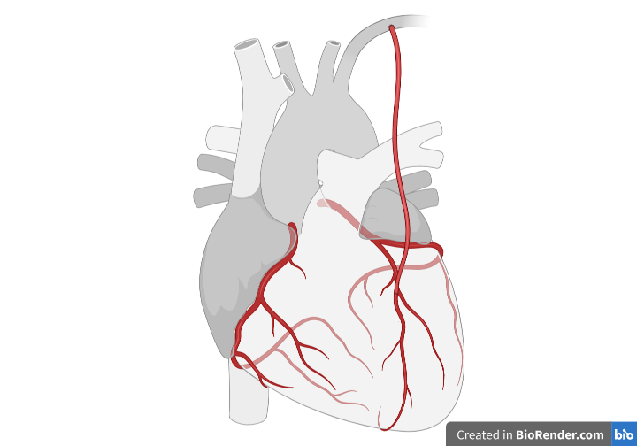
Coronary Artery Disease
By Jeanette Neri

Slide 2
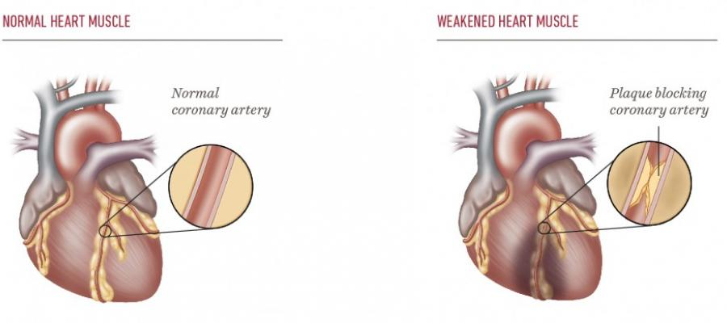
What is Coronary Artery Disease (CAD)?
https://www.templehealth.org/services/conditions/coronary-artery-disease

Slide 3
What are the symptoms of CAD?
Symptoms in MEN
Even though HALF of men that die suddenly from CAD had NO prior symptoms, men with CAD may experience:Heart Attack - chest, neck or back pain, indigestion, nausea or vomiting, extreme fatigue, dizziness or shortness of breath.
Arrhythmia - fluttering feeling in the chest
​Heart Failure - ​shortness of breath, fatigue or swelling in the feet, ankles, legs, abdomen or neck veins
Symptoms in WOMEN
​Women can experience the same symptoms as men, but they also may experience:Angina - chest pain or discomfort
Pain - in the neck, jaw, throat, upper abdomen or back
Nausea
Vomiting
Fatigue

Slide 4
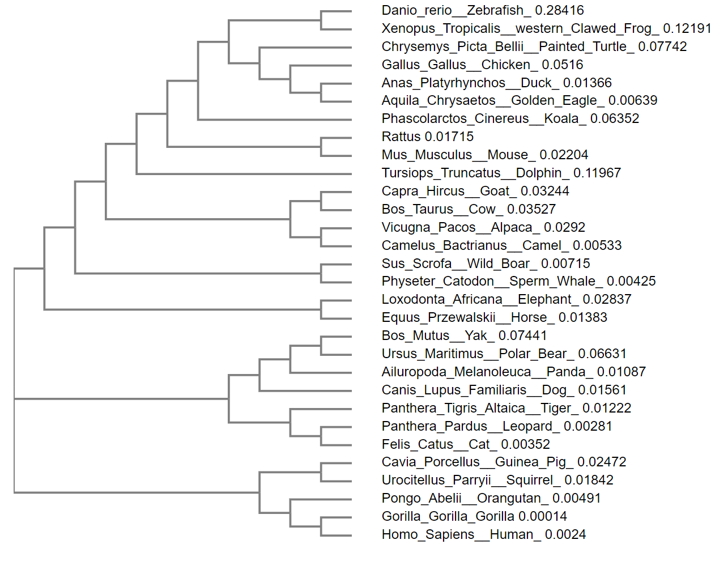
Where else is this gene found?

Slide 5
Homologs of ARNT:
Homo Sapiens
Drosophila
Mus Musculs

